Slide 1

Supporting Sheffield General Practice to work at scale
Dr Andy Hilton
GP partner
CEO Primary Care Sheffield

Slide 2
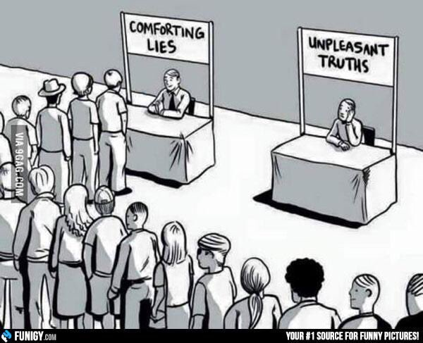
Change is Inevitable

Slide 3
PCS Overarching Strategy
There are three interdependent mutually supporting areas of focus that underpin the strategy for PCS:
    Supporting delivery (or where necessary delivering) of Core Primary Care : Management support, buying group, training, workforce development and employment and through varying levels of input for those looking for support on an ad hoc or bespoke basis
    Delivering ‘wrap around services’ to facilitate and enhance core primary care, includes 7 day access, CASES, neighbourhood support, integrated community care, community based elective services.
    System leadership, innovation and primary care voice at system level: Influencing system change on behalf of shareholders, representing them as providers of primary care with an Accountable Care System.
Core Primary Care
System Leadership & Innovation
Extended & Wrap Around Services
The PCS business model

Slide 4
PCS …at your service or just making more work?
Defend status quo or embrace the inevitable?
GPAF (Satellites) – new investment in primary care
Funding into practices
Governance and resource to deliver
Workforce development and more capacity
Influencing future urgent Primary Care agenda
Supporting Thursday afternoon approach

Slide 5
Referral Management or Developing skills in primary care?
CASES – new investment in practices
Forcing the system to value and respect primary care
Clinical support and professional development
Service quality and reputation
Potential to increase primary care funding by moving activity from secondary care.
A programme of redesign – not referral management
Fully integrated pathways improving patient, GP and Specialist experience

Slide 6
PCS – take overs or a helping hand?
Clover Plus – testing scale
Keeping the market at bay
Retaining GMS conditions
Responding if approached
Exploring all options to support current partners
Link to neighbourhood development
Link to potential new models and GPFV
Notes:
Care trust partnership

Slide 7
PCS – a system cost or a practice resource?
Modest PCS overheads to deliver £m services.
Resources direct to practices for provision/development
Buying group
GPFV practice support
Clinical Pharmacist scheme
Physio First
Practice nurse pool
Health Checks
Future…payroll, CQC, training, locum services
Notes:
Sprinting a marathon

Slide 8
PCS within the wider system – representing or enabling?
GP Practices own PCS
and are members of the CCG
and GPs have LMC as our representative body
All are accountable to GPs…..so all want the same thing?
How can we flex our collective muscle?
Notes:
Key principles paper on tables

Slide 9

System Transformation

Slide 10
Transformation agenda
ACS (was STP) and Sheffield place-based plan (ACP)
  Full stakeholder engagement including primary care as commissioner and provider in NHSS CCG and PCS
  Developing governance at senior executive level
  Emerging ‘Sheffield Accountable Care Partnership’ with early governance structure in operation
  Move towards joint commissioning

Slide 11
ACP Governance
STH
SCT
PCS
SH&C
SCC
(social Care)
SCC
(commissioner)
SCCG
Delegation from Sept 17 Onwards (TBA)
Accountable Care Partnership (ACP) Board
Co-Chairs
Chairs
CEO (Lead)
CEs
DPH
Prog Dir.
ACP Executive Delivery Group
CE Sponsors
Clinical / Care Lead
CEO
Co chair
CE
Co Chair
Functional Exec Directors
Prog. Dir
Workstream 1
Workstream 2
Workstream n
CE Sponsor
W/S Lead
Delivery Resources
(as appropriate)
Clinical Lead
Project
Mgt and support
Enabling Workstreams

Slide 12
Questions for…
…Primary Care:
How to protect what works?
Unified voice vs fragmented primary care
Scale vs local responsiveness
Consistency vs autonomy
Leadership and innovation vs organic growth
How to avoid duplication of work, governance, costs?
….PCS
Accountability
Engagement
Representativeness.

Slide 13
PCS – use us or lose us.
GPs can control what the system does. Working together we have huge influence.
How the money flows needs to produce what’s best for patients.
Lets push for Primary Care led, community delivered elective care services.
Together we can develop an at scale approach to urgent primary care in response to the CCG’s consultation to urgent care strategy.
Neighbourhood development – use PCS to support you to do what you want to do.
Join us; we need your help and we can offer development.

